Slide 1
Earthquakes, Volcanos and Tsunamis

Slide 2
Vocabulary – write a definition for the following
Geosphere/Lithosphere
Hydrosphere
Biosphere
Biomes
Atmosphere

Slide 3
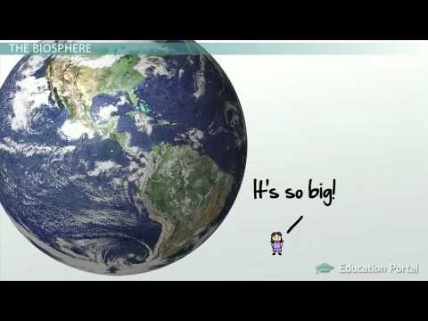

Slide 4
Questions
Which of the four spheres are affected by volcanic eruptions?
How are they affected?

Slide 6
Questions
Which spheres are affected by an Earthquake? How?
Which spheres are affected by a tsunami? How?

Slide 7
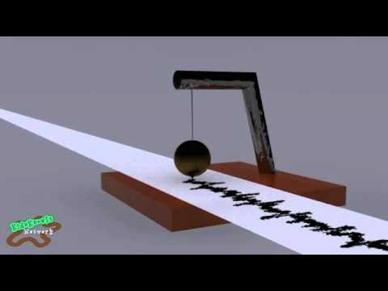
How can we detect Earthquakes, Tsunamis and Volcanoes?

Slide 8
