Slide 1
Distance in Space
Year 9 – What’s out there?

Slide 2
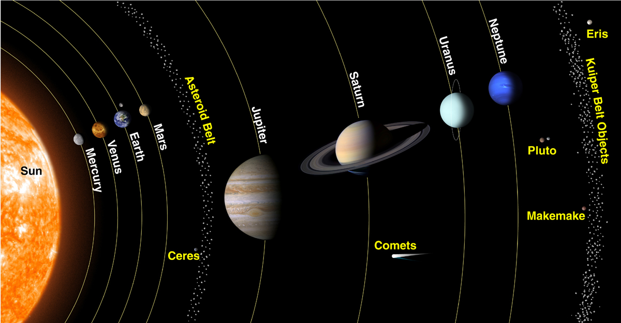
What are we going to learn today?
Key vocabulary for distances in space
How to use astronomical units as measures of distances between the Sun, Earth, and other planets
Calculate the relative distances between the planets using a scale distance
Draw a scale drawing to accurately depict the distance between planets

Slide 3
Earth compared to the rest of the Universe

Slide 4
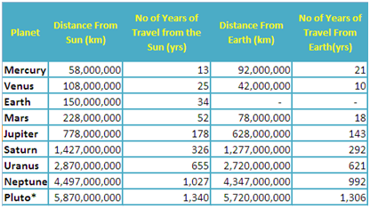
Distances in Space

Slide 5
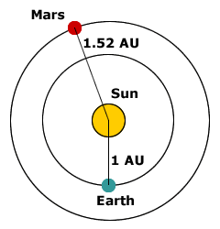
Astronomical Unit
The values for these distances are difficult for astronomers and scientists to work with.
Scientists use a unit of measurement called an astronomical unit (AU),
The average distance between the Earth and the Sun
Approximately 150 000 000 km

Slide 6
Video – Measuring the Universe

Slide 7
Graphing Activity
Planet/Dwarf Planet | Distance in AU | Distance in mm
Mercury | 0.4 | 0.4 x 5 = 2 mm
Venus | 0.7
Earth | 1.0 | 5 mm
Mars | 1.5
Ceres (Asteroid belt) | 2.8
Jupiter | 5.2
Saturn | 9.5
Uranus | 20.0
Neptune | 30.0
Pluto (Dwarf planet) | 40.0
Pl
Np
Ur
St
Jp
Cr
Mr
E
V
M
0 5 10 15 20 25 30 35 40

