Slide 1
How to write an explanation

Slide 2
When do You Use An Explanation?
The purpose is to explain how something works or why something happens.
It includes:
An introduction – a statement stating what is going to be explained.
An explanation sequence – this is where you explain what happens, and how and why it occurs. It is presented in the order it occurs.
A concluding statement – this is not always necessary, but it is where you sum up what you have explained.

Slide 3
Introduction
Write a title
Write an introduction
Write a question or a brief description
Use second or third person
Use present tense
Use technical language
How does rain fall
How does rain fall from the sky?
Rain falls from clouds that are made of tiny droplets of water.

Slide 4
How and why it starts?
What happens next?
What happens after?
What happens in the end?
Explanation
sequence
When the clouds get heavy the droplets are forced together and they get bigger and heavier and fall to the ground.
The cool water droplets gather together and form clouds.
Water droplets are formed when moisture evaporates from the earth.
Water comes from warm air that rises from the ground.

Slide 5
Conclusion
A conclusion is a way to sum up the points you made in the explanation sequence.
Could include…
A summary
A comment about its use
A recommendation

Slide 6
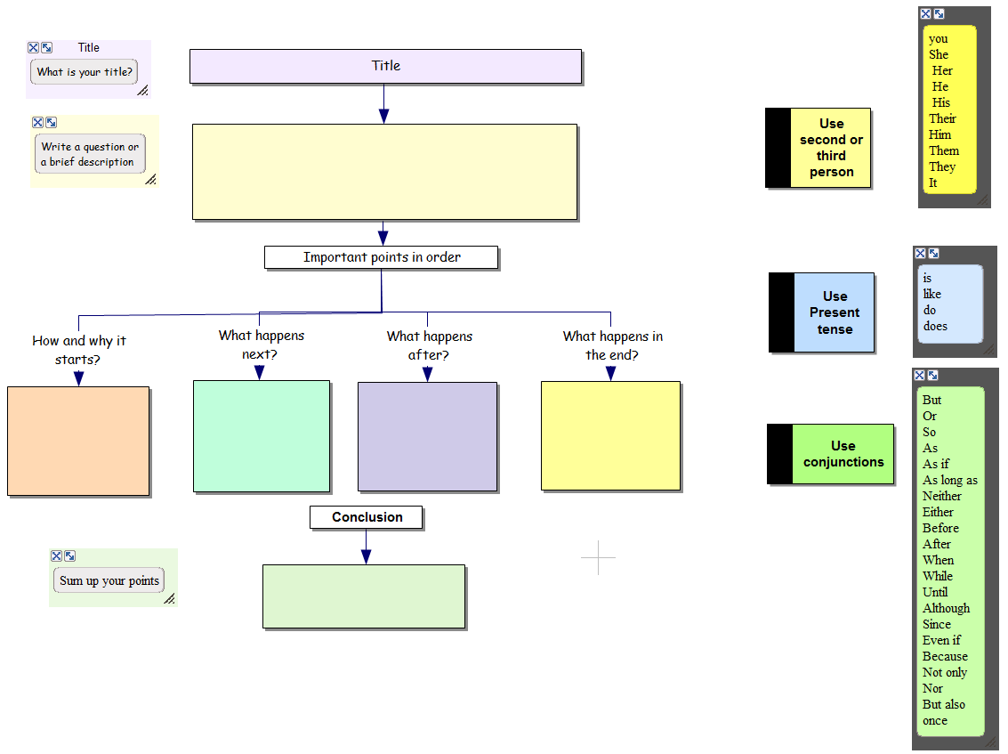

Slide 7
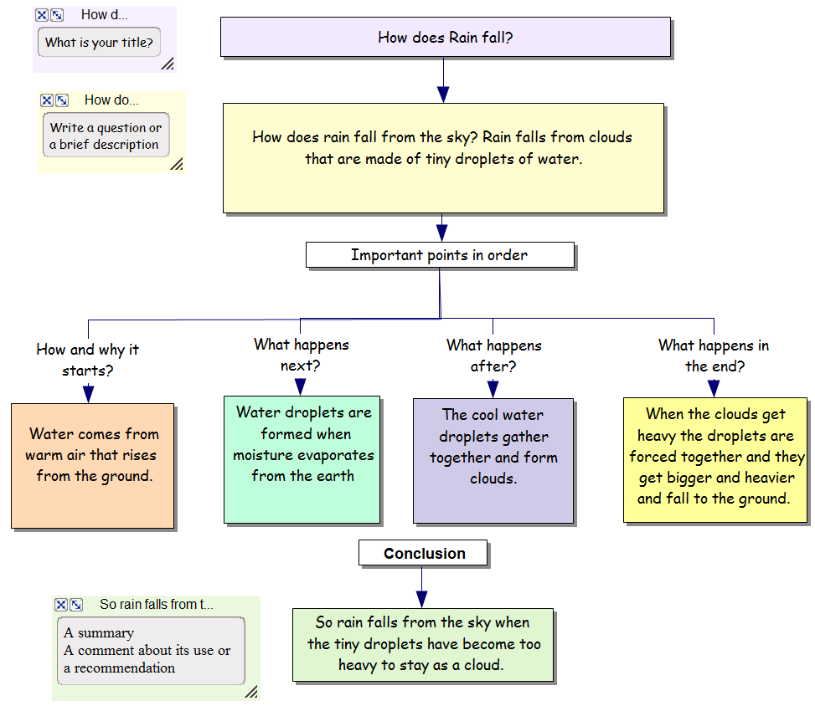

Slide 8
Explanation rubric
Have I
Written in the present tense?
Written in second and third person?
Written an introduction that asks a question or gives a brief description?
Said ‘How or why it starts’?
Said ‘what happens next and after’?
Said what happens in the end?
Written a conclusion with a summary, or a comment?
Have I used other words for ‘and’?
Have I used action verbs?
Have I used technical or scientific words?

Slide 9
Writing Task:
Write a paragraph to explain the basics of a black hole. Start at how it is formed (think about the life cycle of a star).
Information to include in your answer:
Explain how a black hole is born.
Use astronomical terms in explaining the stages that result in a black hole forming. Such terms would be “supernova, interstellar, etc.”
Explain what a black hole is, and why it is named the way it is.
Explain how gravity is involved in black holes.
Why can’t light escape?

